Slide 1

IMMERSIVE VISUAL DATA STORIES
GROUP 4
Presented by,
Gifty Augustine and Kezia Kunju John
Department of Computer Science and Mathematics | University of Passau

Slide 2


OVERVIEW
Introduction
Key concepts
Illustrative examples
Research Question
Evaluating Immersion
Ethical Framework
Conclusion
Future Directions

Slide 3
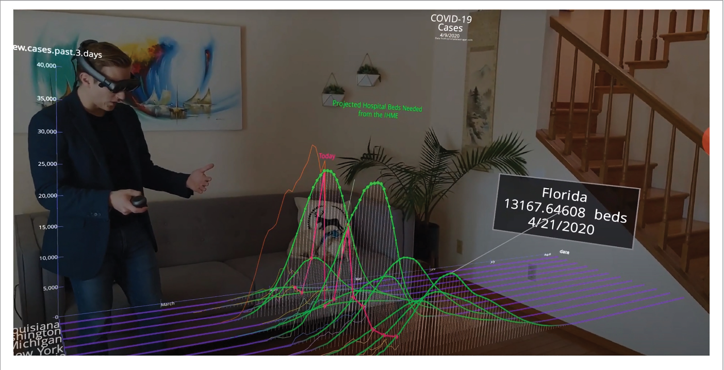
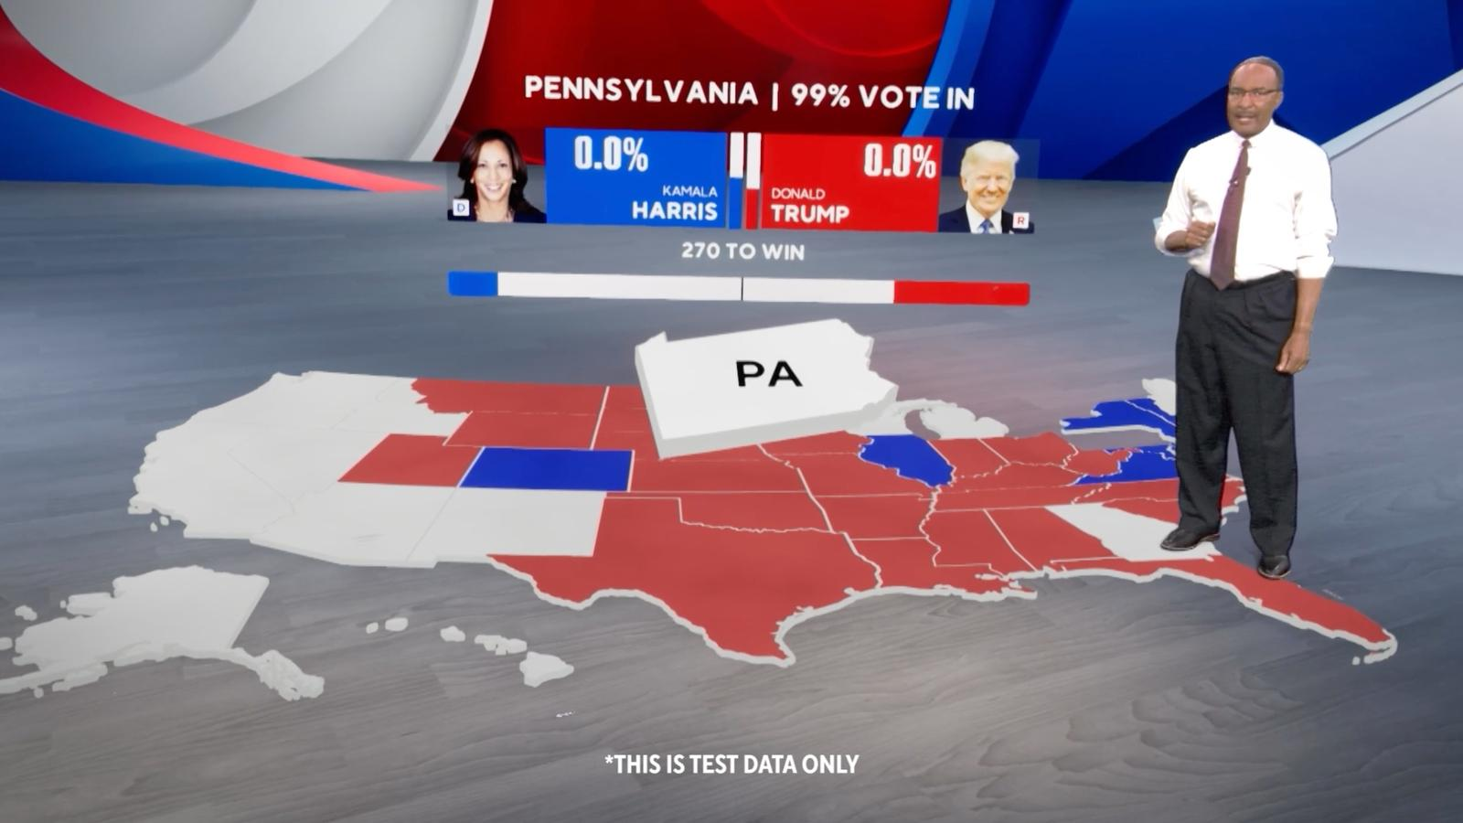
INTRODUCTION
Abundant info, communication hard.
Immersive Storytelling: Data in VR/AR
Why it Matters: Engage & Decide
Ethical considerations and Accessibility
Application:
Education
Healthcare
Research
Engineering and many more

Slide 4
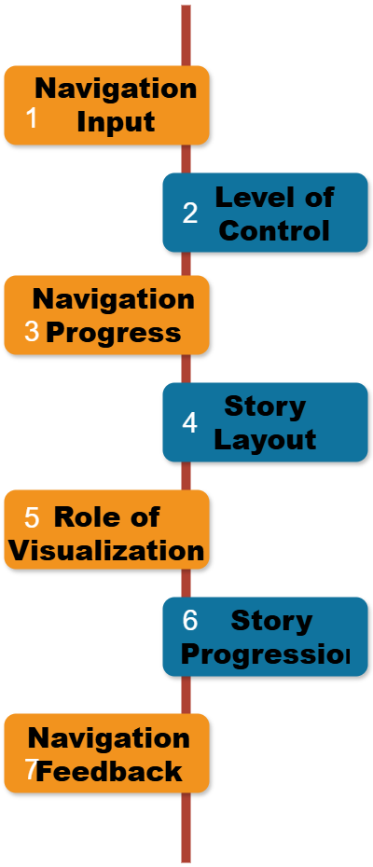
KEY CONCEPTS
Narrative Design and storytelling:
Foundation of effective data-driven stories.
Flow Framework : 7 factors of visual narrative flow.
Studies Conducted: Explored how flow impacts reader experience.
Linear, interactive, and branching designs, supported by tools like SketchStory and ChartAccent
Future Focus: Generalize, explore metrics, analyze factors.
n

Slide 5
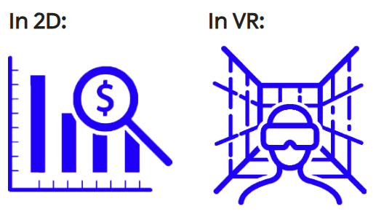
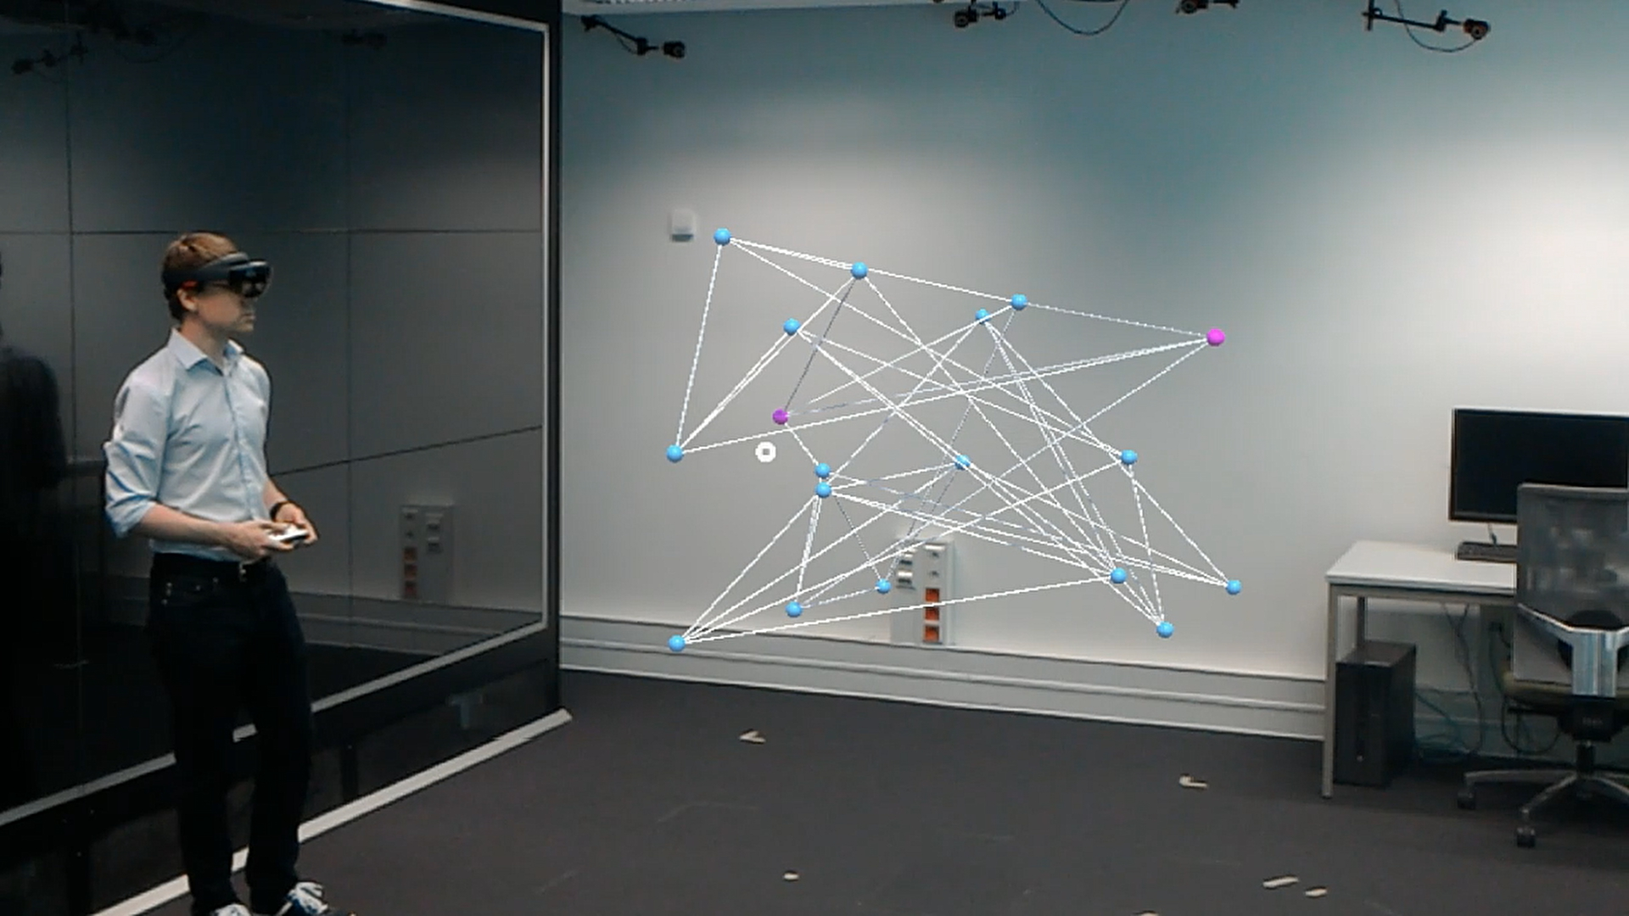
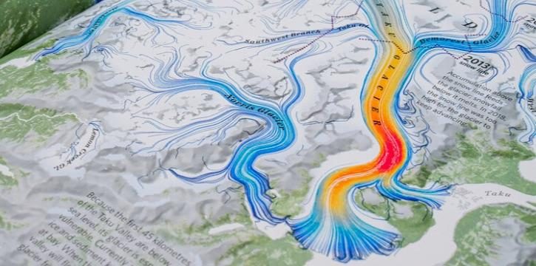
KEY CONCEPTS
Immersive Visualization Techniques:
VR: Fully immersive 3D environments for spatial data exploration (e.g., LookVR: bar charts)
AR: Overlay digital data onto the physical world (e.g., collaborative analysis with AR-enhanced visualizations)
Dynamic Visualizations: Animate data to reveal trends (e.g., Climate change: rising sea levels).

Slide 6
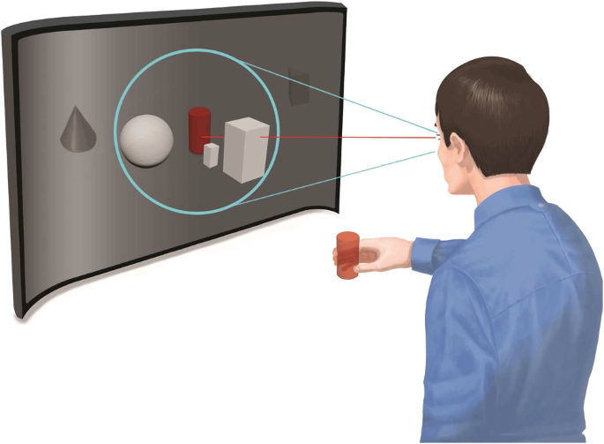
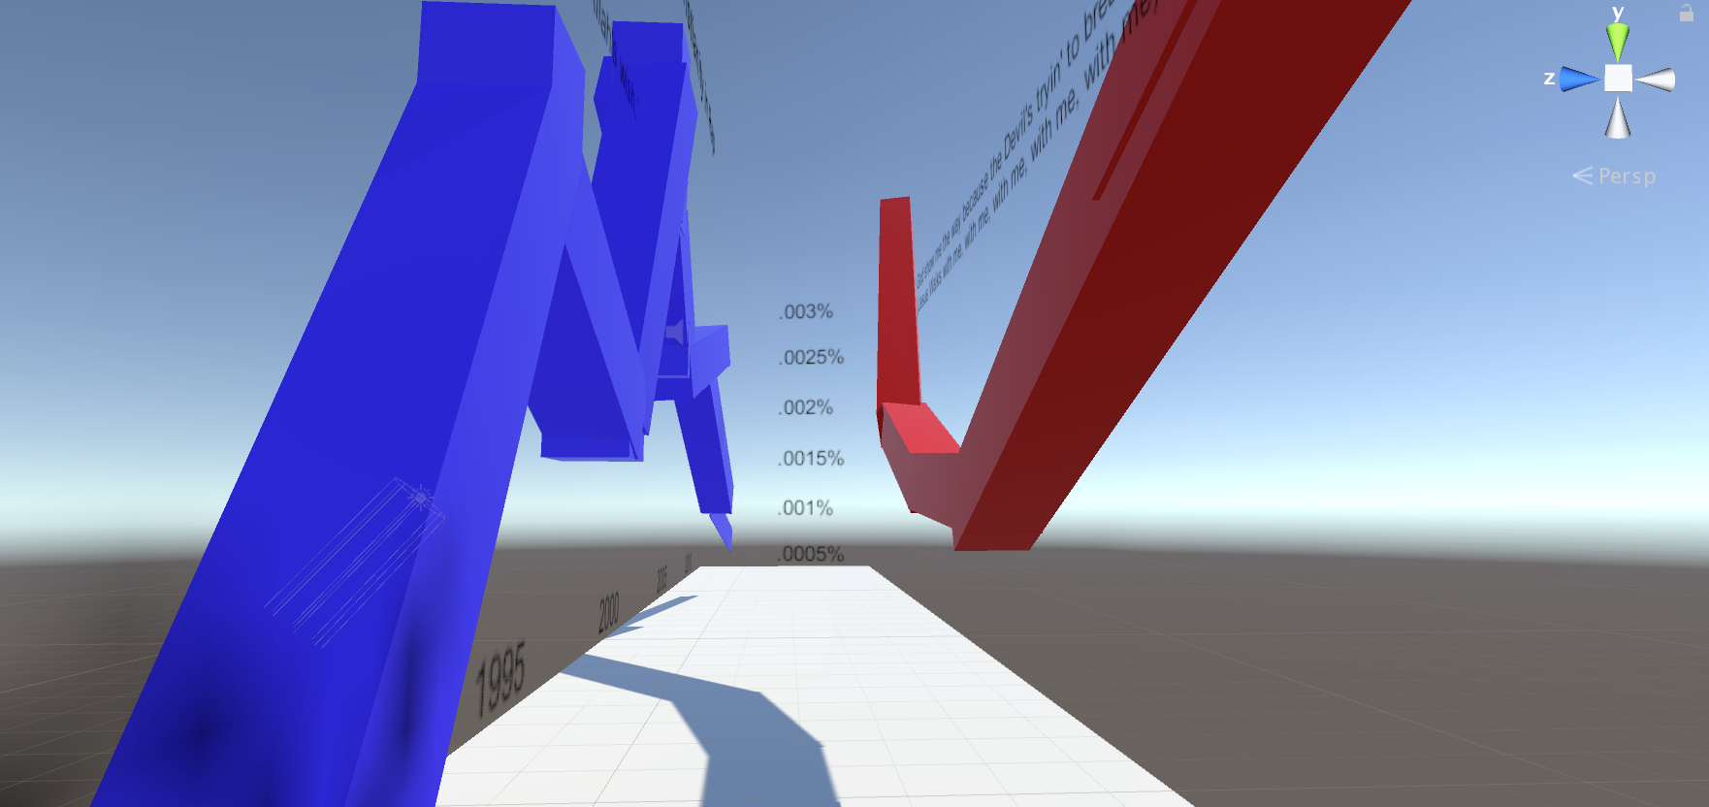

KEY CONCEPTS
Immersive Visualization Techniques:
Embodied Interaction: Natural gestures and gaze tracking for interaction (e.g., Gaze-based object reveal in VR)
Space-Filling Displays: Immersive environments for large datasets without clutter (e.g., Stock market trends as walkable line charts)
Interactive Techniques: User-driven exploration with virtual tools (e.g., Virtualitics: AI-powered collaborative analysis).

Slide 7
KEY CONCEPTS
User Experience and Cognitive Load:
Emotional Engagement: Emotions (fear, stress) drive engagement. Visual/auditory cues and gradual build-up enhance impact
Natural VR Interaction: Gaze-based interactions and adaptive colliders for intuitive exploration
Cognitive Load: Minimize fatigue with careful triggers and feedback
Personalized Storytelling: Gaze-based interactions create unique narratives
Balance Exploration & Guidance: Ensure immersive and accessible experiences.

Slide 8
ILLUSTRATION VIDEO

Slide 9

RESEARCH QUESTIONS
01
Define methods for evaluating immersion and emotional engagement.
02
Explore the ethical frameworks for emotional data narratives.

Slide 10
EVALUATING IMMERSION
Subjective Measures:
Questionnaires: IEQ, PXI assess cognitive involvement, emotional engagement, and dissociation.
Self-Reported Scales: Rank perceived immersion and emotional intensity.
2. Objective Measures:
Physiological Data: GSR, heart rate, EEG measure arousal and emotional responses.
Eye-Tracking: Decreased fixations indicate focused attention.
Task Completion Time: Slower transitions suggest difficulty disengaging.

Slide 11
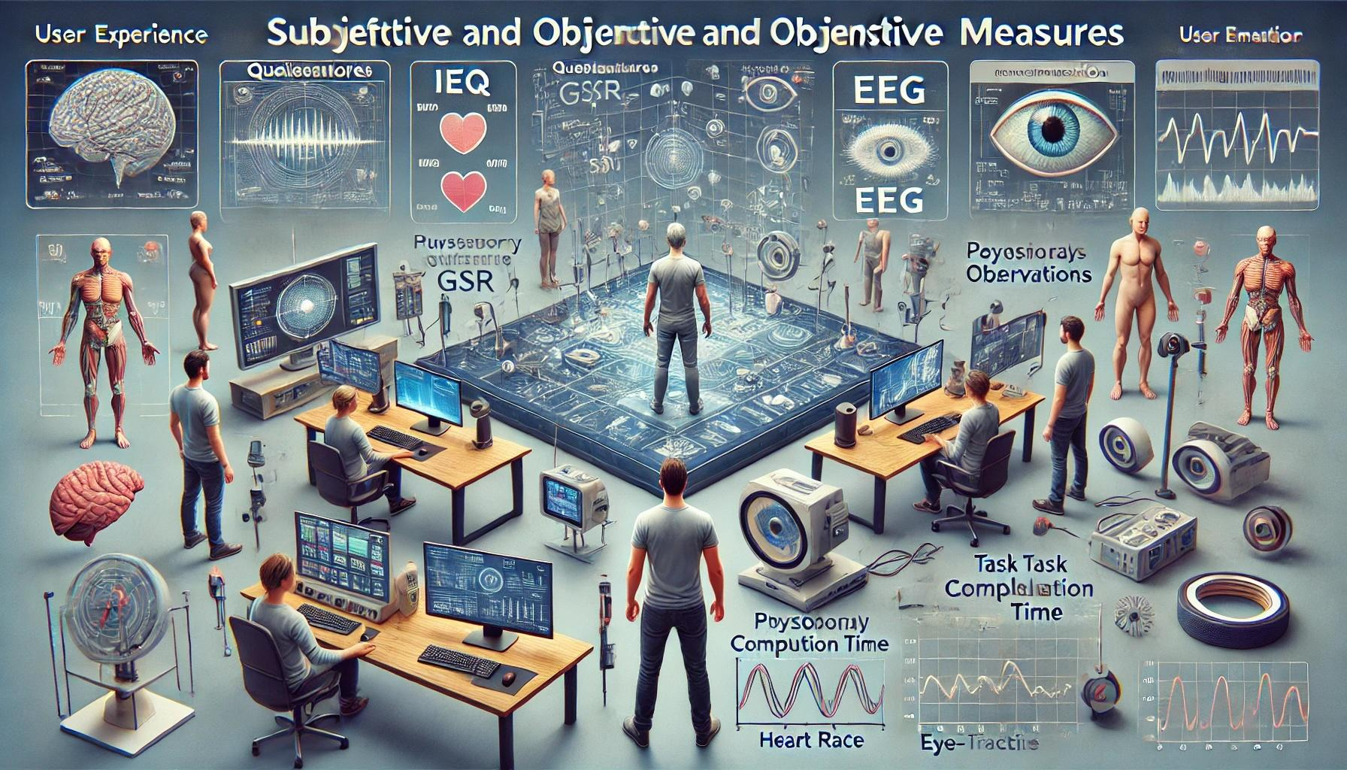
EVALUATING IMMERSION
3. Behavioral Observations:
Monitor body motion, gestures, and spontaneous reactions.
4. Performance Metrics:
Accuracy and reaction times reflect cognitive load.
Exploration patterns reveal user interaction depth.

Slide 12
EMOTIONAL ENGAGEMENT
Contextual Influences:
Physical environment, distractions, group dynamics.
03
Game Design
Narrative: Emotionally charged storylines, interactive choices
Audio-Visual Cues: Lighting, soundscapes, event timing
Factors Influencing
01
02
Personal Factors:
Personality (openness, sensitivity) & past gaming experience

Slide 13
CHALLENGES IN
Subjectivity: Emotions are personal & culturally influenced.
EVALUATING
Technological Barriers: High cost & accessibility of advanced measurement tools.
IMMERSION &
Ethical Concerns: Manipulating emotions for engagement raises ethical issues.
ENGAGEMENT
Complexity: Multifaceted nature of immersion (engagement, engrossment).

Slide 14
ETHICAL FRAMEWORK
Transparency & Accountability: Data integrity, clear attribution, consent.
1
Inclusivity & Accessibility: Universal design, cultural sensitivity, digital inclusion.
2
3
Avoiding Manipulation: Prevent emotional exploitation, combat misinformation, ethical design choices.
Psychological Well-being: Minimize adverse effects, realism vs. escapism, emotional safeguards.
4
5
Governance & Regulation: Ethical oversight, regulating metaverses, legal frameworks.

Slide 15
FUTURE DIRECTIONS
Advanced Metrics:
Standardized physiological & behavioral measures.
AI for real-time emotional tracking & adaptive storytelling.
Dynamic Ethics Models: Address emerging ethical challenges.
Research & Collaboration: Interdisciplinary research for ethical best practices.

Slide 16
CONCLUSION
Immersive visual data storytelling in AR and VR is transforming how we interact with information by blending narrative design, intuitive interaction, and dynamic visualization. As these techniques evolve, their application across fields like education, healthcare, and engineering highlights their potential to make complex data more accessible and emotionally engaging while addressing ethical considerations.

Slide 17
REFERENCES
https://www.researchgate.net/publication/351558543/figure/fig2/AS:11431281238392196@1713901044200/Example-of-a-predictive-simulation-of-augmented-reality-AR-Covid-19-data-for-multiple_W640.jpg
https://www.newscaststudio.com/wp-content/uploads/2024/11/cbs-virtual_20-1024x576.jpg
https://i.ytimg.com/vi/ddc6fWYnURM/hq720.jpg?sqp=-oaymwEhCK4FEIIDSFryq4qpAxMIARUAAAAAGAElAADIQj0AgKJD&rs=AOn4CLCXB7ST48w3nDF87puCf3tlpvJQkw
https://gijn.org/wp-content/uploads/2021/08/Atlas-of-the-Invisible-main-image.jpg
https://media.springernature.com/lw685/springer-static/image/art%3A10.1007%2Fs12193-019-00305-y/MediaObjects/12193_2019_305_Fig1_HTML.png
https://roadtovrlive-5ea0.kxcdn.com/wp-content/uploads/2017/01/maxresdefault-10-300x160.jpg
https://chatgpt.com
https://www.youtube.com/watch?v=MMB3rHeZdcE

Slide 18

THANK YOU!
For your attention
Department of Computer Science and Mathematics | University of Passau

